Slide 1

Statistical Computation Methods for Data Science (6HC17)
By
S.U.RAVI KUMAR CH
Assistant professor of Mathematics
Department of Science and Humanities
Sreenidhi Institute of Science and Technology
Yamnampet, Ghatkesar.
1
Notes:
1

Slide 2
We discuss the following in today’s Lecture
Shrinkage Methods
Ridge regression
Lasso Regression
Computational Advantages of Ridge Regression
Comparison of two methods

Slide 3
Review of previous lecture
The subset selection methods use ordinary least squares (OLS) to fit a linear model that contains a subset of the predictors.
As an alternative, we can fit a model containing all p predictors using a technique that constrains or regularizes the coefficient estimates (i.e. shrinks the coefficient estimates towards zero).
It may not be immediately obvious why such a constraint should improve the fit, but it turns out that shrinking the coefficient estimates can significantly reduce their variance.

Slide 4

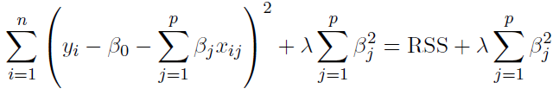
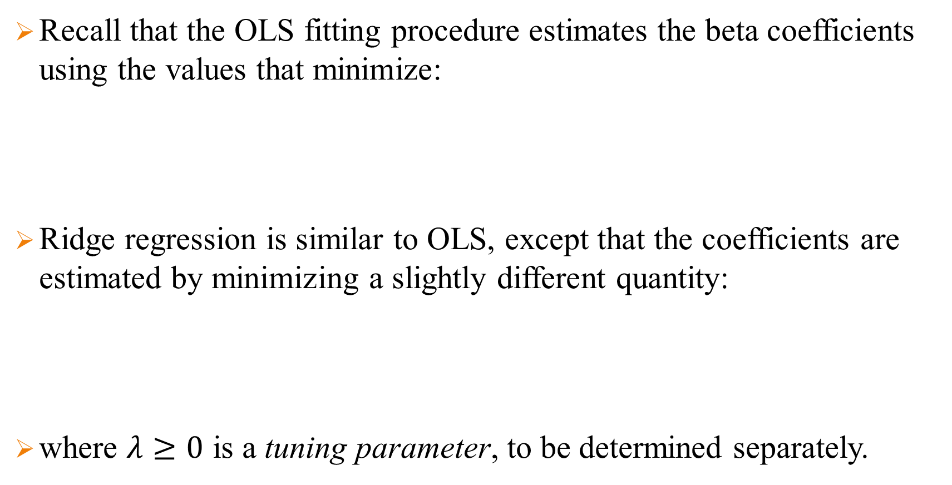
Ridge regression
Recall that the OLS fitting procedure estimates the beta coefficients using the values that minimize:
Ridge regression is similar to OLS, except that the coefficients are estimated by minimizing a slightly different quantity:
where $λ≥0$ is a tuning parameter, to be determined separately.

Slide 5
Ridge regression
Note that 𝜆 ≥ 0 is a complexity parameter that controls the amount of shrinkage.
If 0 < λ < ∞, the magnitude of λ decides the weightage given to the different parts of the objective.
In simple terms, the minimization objective =
RSS + λ (sum of the square of coefficients)
Where RSS is Least Square Objective that is the linear regression objective without regularization.

Slide 6
Ridge regression
The effect of this equation is to add a shrinkage penalty of the form
where the tuning parameter λ is a positive value.
This has the effect of shrinking the estimated beta coefficients towards zero. It turns out that such a constraint should improve the fit, because shrinking the coefficients can significantly reduce their variance.

Slide 7
Ridge regression
Note that when λ = 0, the penalty term as no effect, and ridge regression will procedure the OLS estimates. Thus, selecting a good value for λ is critical (can use cross-validation for this).
As λ increases, the standardized ridge regression coefficients shrinks towards zero.

Slide 8
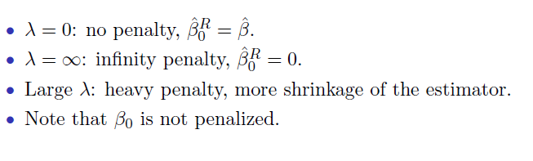
Ridge regression
Thus, when λ is extremely large, then all of the ridge coefficient estimates are basically zero; this corresponds to the null model that contains no predictors.

Slide 9
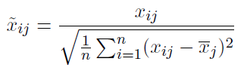
Standardize the inputs
The standard OLS coefficient estimates are scale equivariant.
However, the ridge regression coefficient estimates can change substantially when multiplying a given predictor by a constant, due to the sum of squared coefficients term in the penalty part of the ridge regression objective function.
Thus, it is best to apply ridge regression after standardizing the predictors:

Slide 10
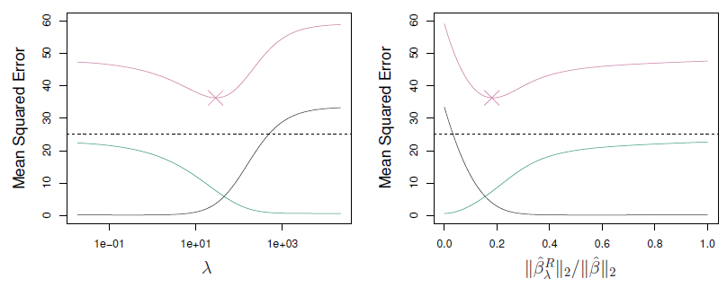

Slide 11
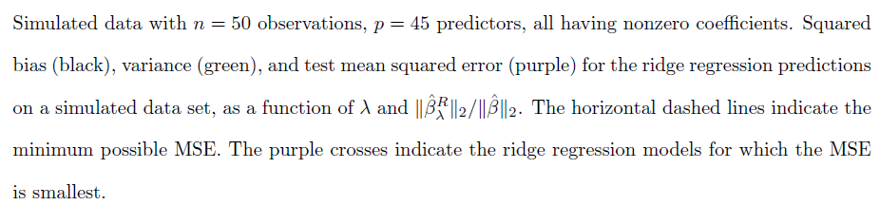

Slide 12
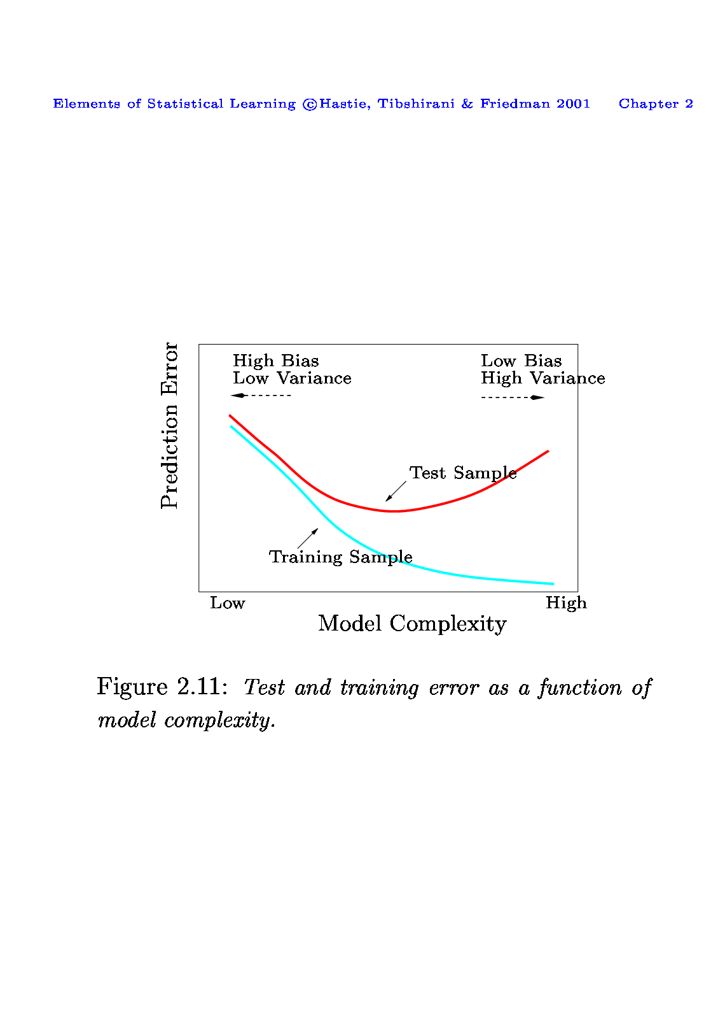
Ridge regression
In general, the ridge regression estimates will be more biased than the OLS ones but have lower variance.
Ridge regression will work best in situations where the OLS estimates have high variance.

Slide 13
Ridge regression
Computational Advantages of Ridge Regression
If p is large, then using the best subset selection approach requires searching through enormous numbers of possible models.
With ridge regression, for any given λ we only need to fit one model and the computations turn out to be very simple.
Ridge regression can even be used when p > n, a situation where OLS fails completely (i.e. OLS estimates do not even have a unique solution).

Slide 14
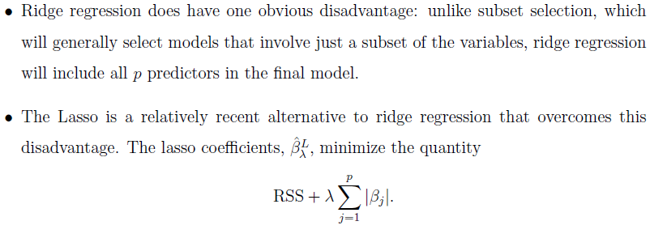

Slide 15
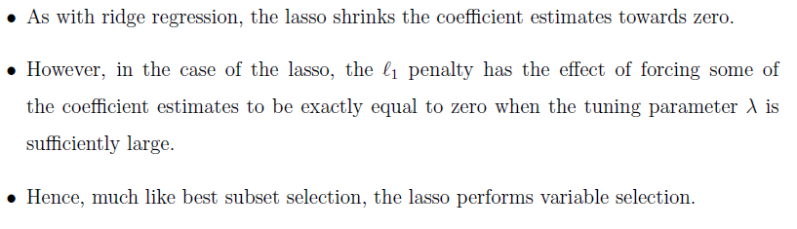
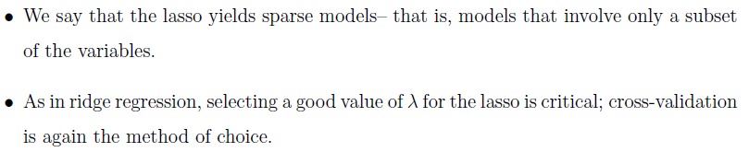

Slide 16
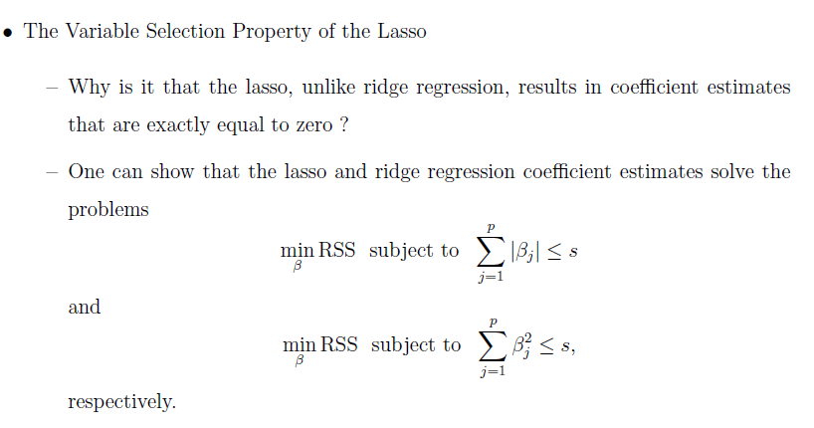

Slide 17
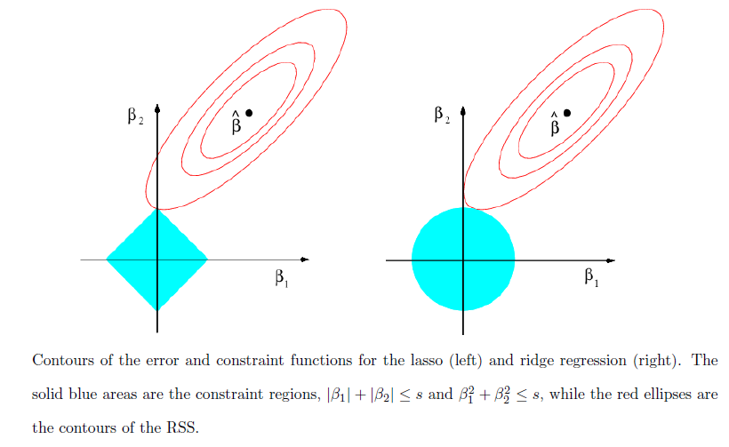

Slide 19
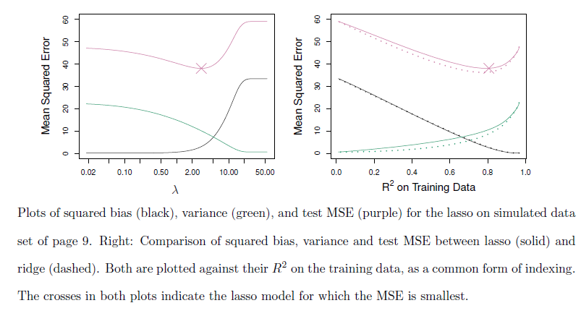

Slide 20
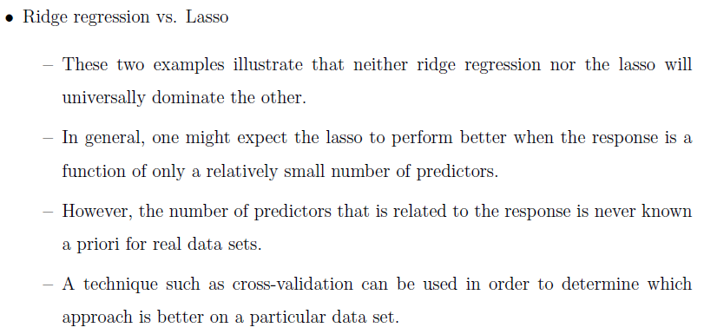

Slide 21
Recapitulation:
Ridge regression
Standardize the inputs
Computational Advantages of Ridge Regression

Slide 22
THANK YOU
Feed Back to santhoshn@sreenidhi.edu.in
Notes:
22

